Slide 1



Course Project Presentation
Edward Alvarado
CIS247C – 4/19/2021

Slide 2
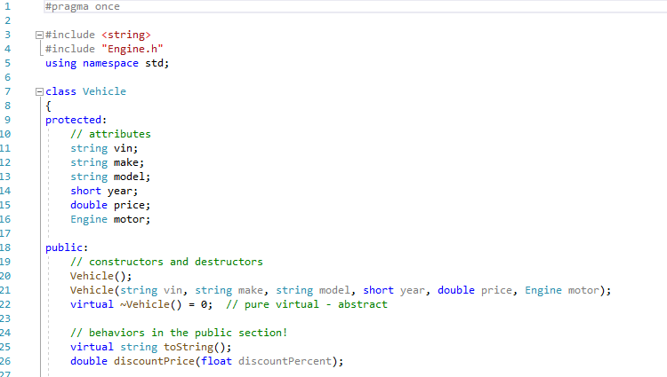
Code Walkthrough
The core principle in this code is utilizing composition, inheritance and polymorphism to reduce code repetition and streamline future additions.
Establishing proper syntax usage was one of the biggest challenges early on.
In the included block of code we see the Vehicle parent class header file which will act as our foundation for the child classes to come.

Slide 3
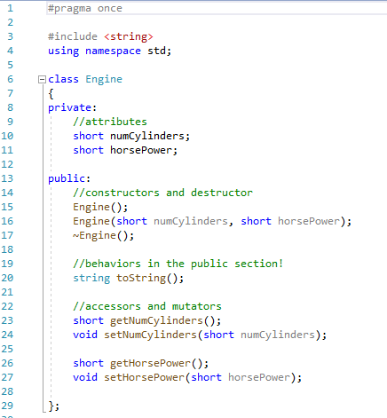
Code Walkthrough
The following code shows an example of composition.
Composition if the idea of an object being comprised of multiple parts (has-a relationship)
In this example a vehicle has-a engine.

Slide 4
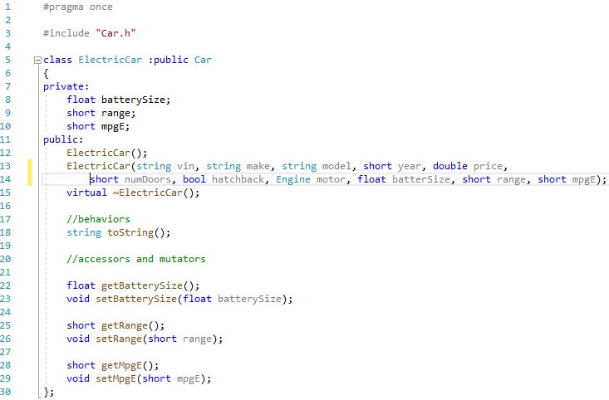
Code Walkthrough
In this example we see multiple layers of inheritance at work.
Starting with Car.h and working down to ElectricCar.h.
Car is receiving its base from Vehicle and ElectricCar is receiving its base from Car.

Slide 5
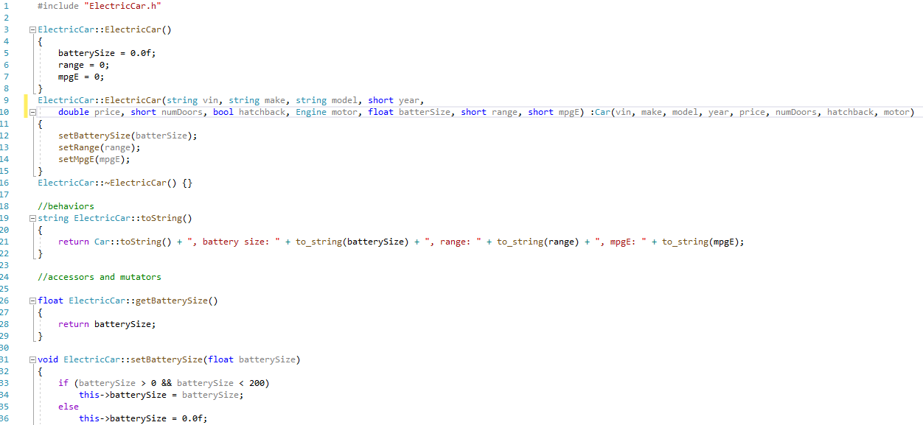
Code Walkthrough
In this example we’re looking at the implementation file for ElectricCar.cpp.
We can see how the parameterized constructor is taking base attributes from car. (Line 10)
Another highlight of this example is utilizing error checking within the mutators to ensure parameters are set correctly. (Line 33)

Slide 6
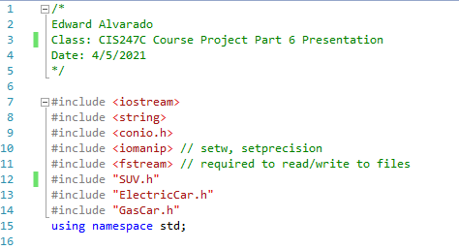
Code Walkthrough
Here we have the beginning of our Source.cpp.
Notice the #Include section doesn’t include every header we have since inheritance will take care of some of the parents.
The top portion of the code I have included in my Toolbox to make starting the next program.

Slide 7
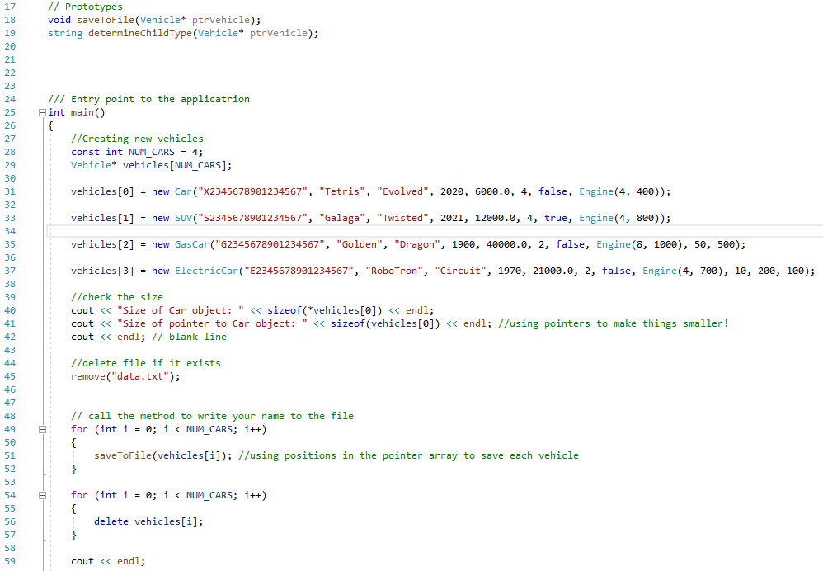
Code Walkthrough
Here we have our main block of code which establishes a dynamic vehicle array with multiple types of vehicles.
We also see the power of pointers here in reducing the memory usage and size of our code.
Towards the end of the code, we release memory once we are done running.

Slide 8
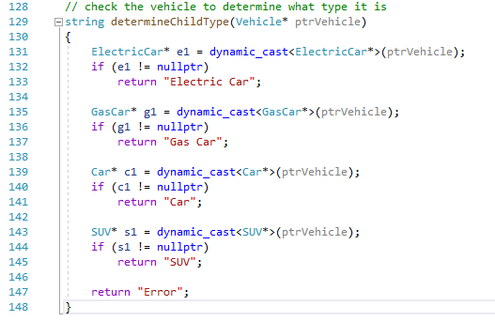
Code walkthrough
Under our main we have our prototypes getting fleshed out.
Here we have our determineChildType code which takes in our vehicle data and determines what type of vehicle it is.
The code checks for nullptr (e1 != nullptr) and returns the car type in a string.

Slide 9
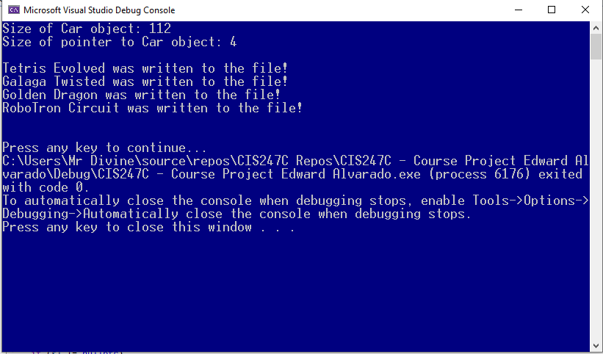
Program Screenshot
Here we can see the program running.
The first line shows the size of the Car object without using pointers.
The second line shows the power of pointers in reducing size!
The final section shows our different objects being written to our data.txt file.

Slide 10
Conclusion
In this course I have learned invaluable skills and techniques for not only C++ but coding in general.
The simple concept of object-oriented programming takes our real life world of objects and converts them into pieces to incorporate into one another as well as work as a blueprint for future code.
Composition, Inheritance and Polymorphism will be techniques I will use for the rest of my career.

